Slide 1

Subject → Internet Of things (EE 629)
Professor → Dr.Kevin Lu
Present By →
Kishan Teli – 10456445
Rohan Ratwani – 10453845

Slide 2


Using Raspberry Pi Over Internet
Internet Of things

Slide 3




Hardware Used in Projects
Raspberry Pi 3B
LED(Generic)
Jumper Wires
Breadboard(Generic)

Slide 4
Step By Step Workflow
1. Creating Bot from Telegram API
Step 1 :- Open Telegram App in your system or mobile
Step 2 :- Find BotFather
Step 3 :- Create New Bot by typing /newbot
Step 4 :- Name Your Bot (Example :- Rratwani_bot)
Step 5 :- Then you get your token for integration

Slide 5
Step By Step Workflow
2. Installation of telegram bot in Raspberry Pi
Step 1 :- Install “telepot”
Step 2 :- Clone the Git Code
git clone https://github.com/KishanTeli/Telegrambot.git
Step 3 :- Paste your bot token in code
Step 4 :- Run the code

Slide 6
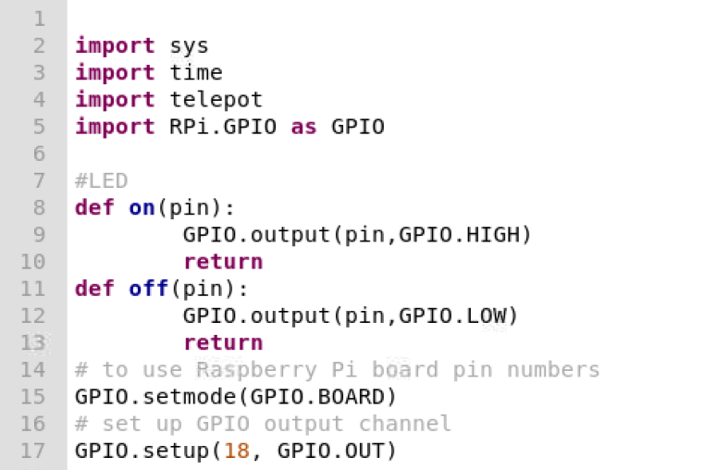
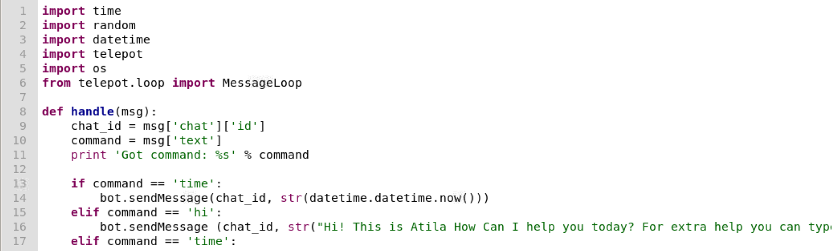
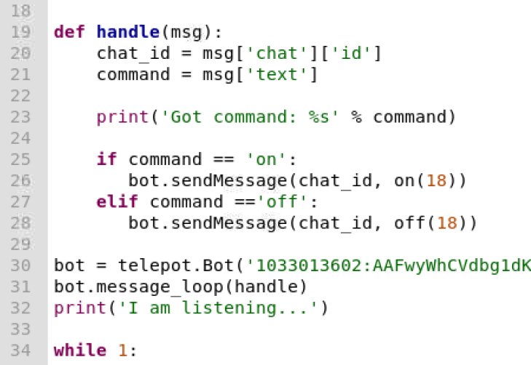
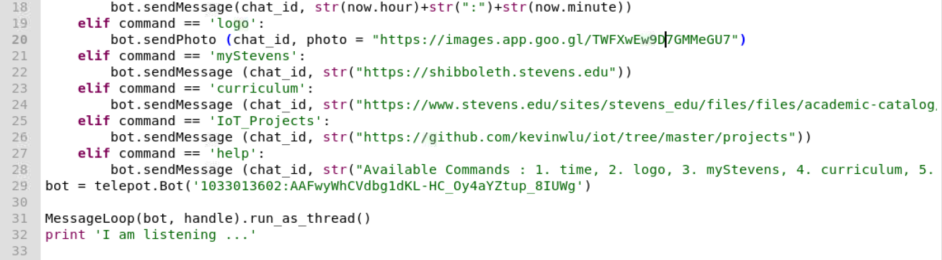
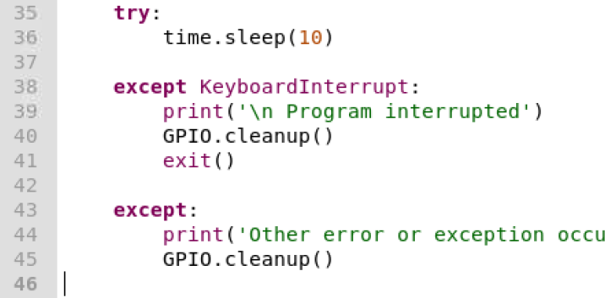
Code

Slide 7
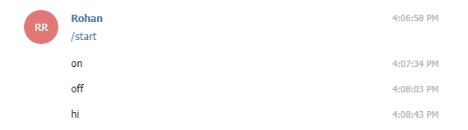
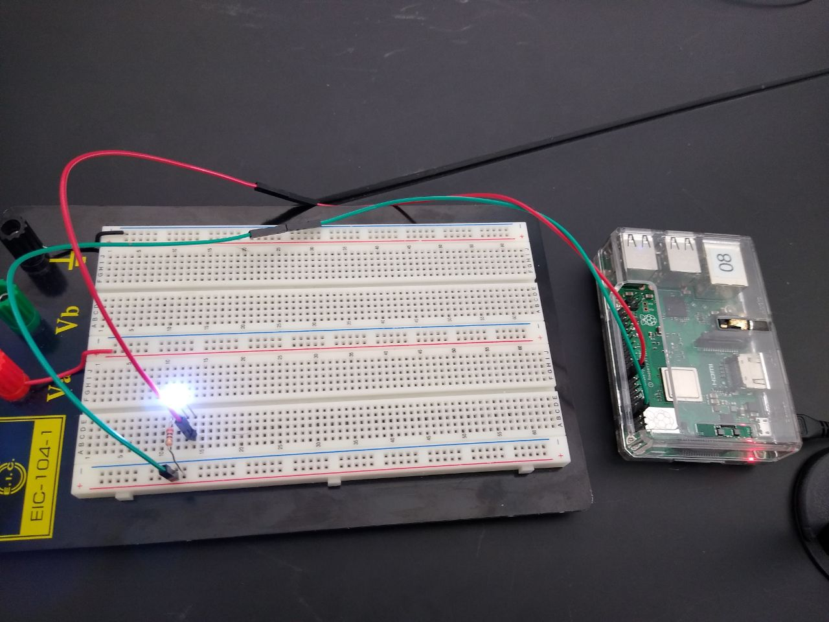
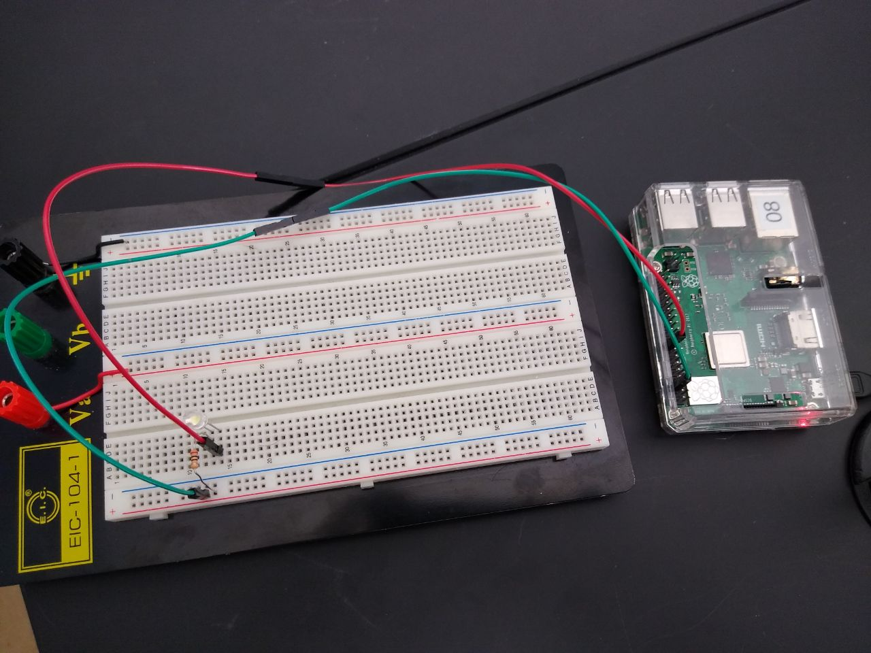
Working Screen Shots
1. Turn On/Off LED using Telegram App
When on command sent to bot
When off command sent to bot

Slide 8
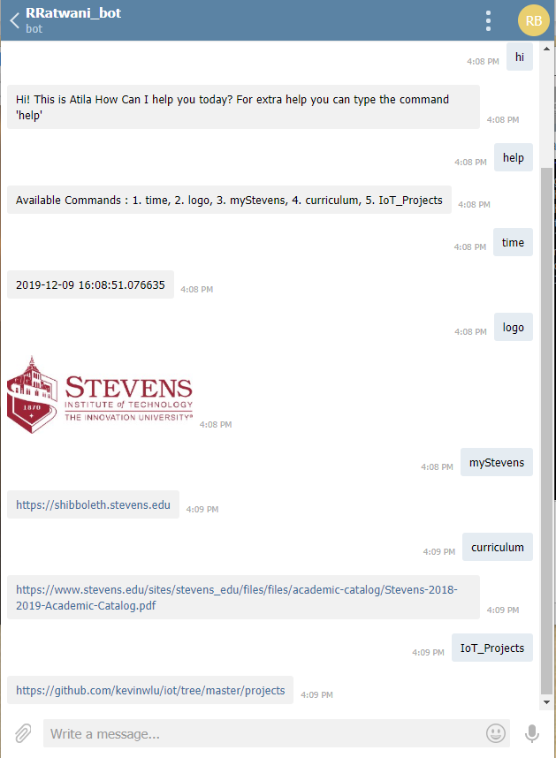
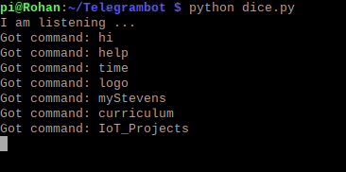
Working Screen Shots
2. Get some information related to Stevens through Bot

Slide 9


